Slide 1
COMP1694 – Artificial Intelligence Dr Damon Daylamani-Zad d.d.zad@gre.ac.uk
AI in Games

Slide 2
MinMax and Game Theory

Slide 3
Zero Sum/Non-Zero Sum Games
Zero Sum:
the fortunes of the players are inversely related
One player’s gain is the other’s loss.
Tennis, Chess, Football, Boxing, etc.
Non-Zero Sum:
One player's gain need not be bad news for the other(s)
The outcome would be either equally good for all of them or equally bad. (It is equally good.)
Cooperative games, team fortunes, Capture the flag.
In the real-world situations are generally not so clear cut.
Interests could/would overlap.

Slide 4
Prisoner’s Dilemma
Two partners in crime are being interrogated separately.
The state lacks the evidence to convict them of the crime they committed but does have enough evidence to convict both on a lesser charge bringing, say, a one-year prison term for each.
The prosecutor wants conviction on the more serious charge, and pressures each man individually to confess and implicate the other.
She says: "If you confess but your partner doesn't, I'll let you off free and use your testimony to lock him up for ten years. And if you don't confess, yet your partner does, you go to prison for ten years. If you confess and your partner does too, I'll put you both away, but only for three years."
The question is: Will the two prisoners cooperate with each other, both refusing to confess? Or will one or both of them "defect" ("cheat")?

Slide 5
Prisoners Dilemma
 |  |  | Prisoner 1
Prisoner 2 |  |  | Confess | Keep quite
 | Confess |  | -3, -3 | 0, -10
 | Keep quite |  | -10, 0 | -1, -1

Slide 6
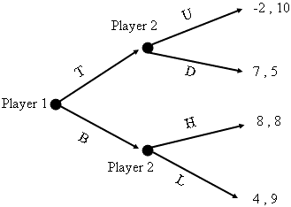
Backward Induction
It is the process of reasoning backwards in time, from the end of a problem or situation, to determine a sequence of optimal actions.

Slide 7
MinMax - Overview
MinMax is at the heart of almost every computer board game
Applies to games where:
Players take turns
Have perfect information
Chess, Checkers, Tactics
But can work for games without perfect information or chance
Poker, Monopoly, Dice
Can work in real-time (ie- not turn based) with timer (iterative deepening)

Slide 8
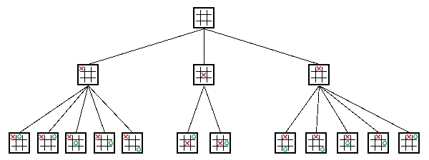
MinMax - Overview
Search tree
Squares represent decision states (ie- after a move)
Branches are decisions (ie- the move)
Start at root
Nodes at end are leaf nodes
Ex: Tic-Tac-Toe (symmetrical positions removed)
Unlike binary trees can have any number of children
Depends on the game situation
Levels usually called plies (a ply is one level)
Each ply is where turn switches to other player
Players called Min and Max (next)
Image Created by the People at AI Horizon <http://www.aihorizon.com/>

Slide 9
MaxMin - Algorithm
Named MinMax because of algorithm behind data structure
Assign points to the outcome of a game
Ex: Tic-Tac-Toe: X wins, value of 1. O wins, value -1.
Max (X) tries to maximise point value, while Min (O) tries to minimise point value
Assume both players play to best of their ability
Always make a move to minimise or maximise points
So, in choosing, Max will choose best move to get highest points, assuming Min will choose best move to get lowest points

Slide 10
MinMax – Example 1
Max’s turn
Would like the “9” points (the maximum)
But if choose left branch, Min will choose move to get 3
→ left branch has a value of 3
If choose right, Min can choose any one of 5, 6 or 7 (will choose 5, the minimum)
→ right branch has a value of 5
Right branch is largest (the maximum) so choose that move
(Remember Backward Induction)
5
Max
3
4
5
Min
3
9
4
5
6
7
Max

Slide 11
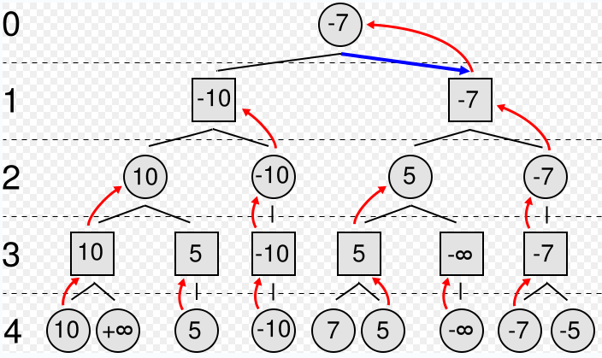
MinMax – Example 2
Max’s turn
Circles represent Max, Squares represent Min
Values inside represent the value the MinMax algorithm
Red arrows represent the chosen move
Numbers on left represent tree depth
Blue arrow is the chosen move
Max
Min
Max
Min

Slide 12
MinMax and Chess
With full tree, we can determine best possible move
However, full tree is impossible for some games! Ex: Chess
At a given time, chess has ~ 35 legal moves. Exponential growth:
35 at one ply, 35² = 1225 at two plies … 35⁶ = 2 billion and 35¹⁰ = 2 quadrillion
Games can last 40 moves (or more), so 35⁴⁰ … Stars in universe: ~ 2²⁸
For large games (Chess) where we can’t see end of the game. We must estimate winning or losing from top portion
Evaluate() function to guess the end, given the board
A numeric value, much smaller than victory (ie- Checkmate for Max will be one million, for Min minus one million)
So, computer’s strength at chess comes from:
How deep can search
How well can evaluate a board position
(In some sense, like a human – a chess grand master can evaluate board better and can look further ahead)

Slide 13
MinMax – Pseudo Code (1 of 3)
int MinMax(int depth) {
// White is Max, Black is Min
if (turn == WHITE)
return Max(depth);
else
return Min(depth);
}
Then, call with:
value = MinMax(5); // search 5 plies

Slide 14
MinMax – Pseudo Code (2 of 3)
int Max(int depth) {
int best = -INFINITY; // first move is best
if (depth == 0)
return Evaluate();
GenerateLegalMoves();
while (MovesLeft()) {
MakeNextMove();
val = Min(depth – 1); // Min’s turn next
UnMakeMove();
if (val > best)
best = val;
}
return best;
}

Slide 15
MinMax – Pseudo Code (3 of 3)
int Min(int depth) {
int best = INFINITY; // ← different than MAX
if (depth == 0)
return Evaluate();
GenerateLegalMoves();
while (MovesLeft()) {
MakeNextMove();
val = Max(depth – 1); // Max’s turn next
UnMakeMove();
if (val < best) // ← different than MAX
best = val;
}
return best;
}

Slide 16
MinMax – AlphaBeta Pruning
MinMax searches entire tree, even if in some cases the rest can be ignored
Example – Enemy has lost a bet. Owes you one thing from his bags. You choose the bag, but he chooses thing. Go through bags one item at a time.
First bag: Premier VIP tickets, sandwich, £20
He’ll choose sandwich
Second bag: Dead fish, …
He’ll choose fish. Doesn’t matter if rest is car, £500, Holiday package… Don’t need to look further. Can prune.
In general, stop evaluating move when find worse than previously examined move
→ Does not benefit the player to play that move, it need not be evaluated any further.
→ Save processing time without affecting final result

Slide 17
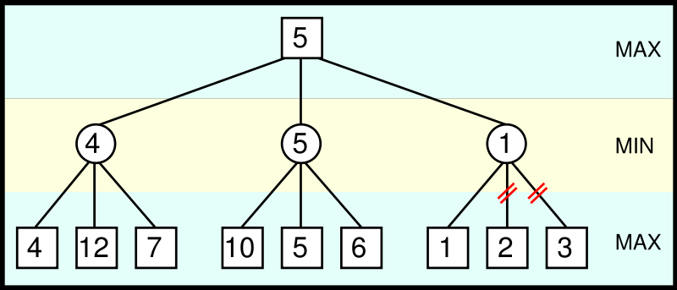
MinMax – AlphaBeta Pruning Example
From Max point of view, 1 is already lower than 4 or 5, so no need to evaluate 2 and 3 (bottom right) → Prune

Slide 18
MinMax – AlphaBeta Pruning Idea
Two scores passed around in search
Alpha – best score by some means
Anything less than this is no use (can be pruned) since we can already get alpha
Minimum score Max will get
Initially, negative infinity
Beta – worst-case scenario for opponent
Anything higher than this won’t be used by opponent
Maximum score Min will get
Initially, infinity
Recursion progresses, the "window" of Alpha-Beta becomes smaller
Beta < Alpha → current position not result of best play and can be pruned

Slide 19
AI Agents

Slide 20
Game Agents
Most AI focuses around game agent
think of agent as NPC: enemy, ally or neutral
Loops through: sense-think-act cycle
Acting is event specific, so we will talk about sense and think first, then a bit on act
Sense
Think
Act

Slide 21
Game Agents – Sensing (1 of 2)
Gather current world state: barriers, opponents, objects, …
Needs limitations: avoid “cheating” by looking at game data
Typically, same constraints as player (vision, hearing range, etc.)
Vision
Can be quite complicated (CPU intensive) to test visibility (i.e. - if only part of an object visible)
Compute vector to each object
Check magnitude (i.e. - is it too far away?)
Check angle (dot product) (i.e. - within 120° viewing angle?)
Check if obscured. Most expensive, so do last.

Slide 22
Game Agents – Sensing (2 of 2)
Hearing
Ex- tip-toe past, enemy doesn’t hear, but if run past, enemy hears (stealth games, like Thief)
Implement as event-driven
When player performs action, notify agents within range
Rather than sound reflection (complicated) usually distance within bounded area
Can enhance with listen attributes by agent (if agent is “keen eared” or paying attention)
Communication
Model sensing data from other agents
Can be instant (i.e. - connected by radio)
Or via hearing (i.e. - shout)
Reaction times
Sensing may take some time (i.e. - don’t have agent react to alarm instantly, seems unrealistic)
Build in delay. Implement with simple timer.

Slide 23
Game Agents – Thinking (1 of 3)
Evaluate information and make decision
As simple or elaborate as required
Generally, two ways:
Pre-coded expert knowledge
Typically hand-crafted “if-then” rules + “randomness” to make unpredictable
Search algorithm for best (optimal) solution
Ex- MinMax

Slide 24
Game Agents – Thinking (2 of 3)
Expert Knowledge
Finite State Machines, decision trees, … (FSM most popular)
Appealing since simple, natural, embodies common sense and knowledge of domain
Ex: See enemy weaker than you? → Attack.
See enemy stronger? → Go get help
Trouble is, often does not scale
Complex situations have many factors
Add more rules => becomes brittle
Still, often quite adequate for many AI tasks
Many agents have quite narrow domain, so doesn’t matter

Slide 25
Game Agents – Thinking (3 of 3)
Search
Look ahead and see what move to do next
Ex: piece on game board (MinMax), pathfinding (A*)
Works well with known information (ie- can see obstacles, pieces on board)
Machine learning
Evaluate past actions, use for future action
Techniques show promise, but typically too slow

Slide 26
Game Agents – Acting (1 of 2)
Learning and Remembering
May not be important in many games where agent is short-lived (ie- enemy drone)
But if alive for 30+ seconds, can be helpful
i.e. - player attacks from right, so shield right
Implementation - to avoid too much information, can have fade from memory (by time or by queue that becomes full)

Slide 27
Game Agents – Acting (2 of 2)
Making agents stupid
Many cases, easy to make agents dominate
Ex: FPS bot always makes head-shot
Dumb down by giving “human” conditions, longer reaction times, make unnecessarily vulnerable, have make mistakes
Agent cheating
Ideally, don’t have unfair advantage (such as more attributes or more knowledge)
But sometimes might “cheat” to make a challenge
Remember, that’s the goal, AI lose in challenging way
Best to let player know

Slide 28
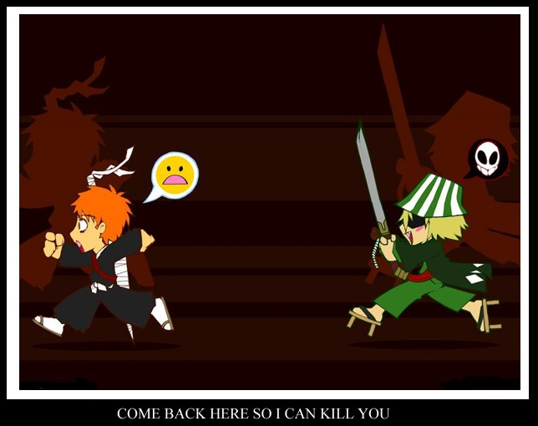
Decision Making
The ability of an agent to decide what to do. Carrying out that decision (movement, animation, attack, shoot, run away, etc.)
Blackboard Architecture
Decision Trees
State Machines

Slide 29
Blackboard architectures
A blackboard system isn’t a decision making tool in its own right.
It is a mechanism for coordinating the actions of several decision makers/agents.
.
Basic Procedure:
Experts look at the board and indicate their interest.
The arbiter selects an expert to have control.
The expert does some work, possibly modifying the blackboard.
The expert voluntarily relinquishes control.

Slide 30
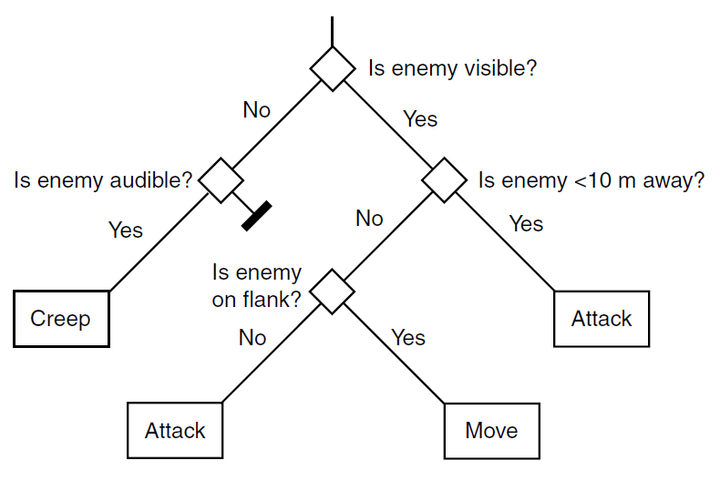
Decision Trees
TellTale Games: The Walking Dead, Game of Thrones, etc.

Slide 31
Finite State Machines
Many different rules for agents
Ex: sensing, thinking and acting when fighting, running, exploring…
Can be difficult to keep rules consistent!
Try Finite State Machine
Probably most common game AI software pattern
Natural correspondence between states and behaviors
Easy: to diagram, program, debug
General to any problem
See AI Depot - FSM
For each situation, choose appropriate state
Number of rules for each state is small

Slide 32
Finite State Machines
Abstract model of computation
Formally:
Set of states
A starting state
An input vocabulary
A transition function that maps inputs and the current state to a next state

Slide 33
Finite State Machines – Example (1 of 2)
Game raid Egyptian Tomb
Mummies! Behavior
Spend all of eternity wandering in tomb
When player is close, search
When see player, chase
Make separate states
Define behavior in each state
Wander – move slowly, randomly
Search – move faster, in lines
Chasing – direct to player
Define transitions
Close is 100 meters (smell/sense)
Visible is line of sight
Wandering
Close by
Far away
Searching
Visible
Hidden
Chasing

Slide 34
Finite State Machines – Example (2 of 2)
Can be extended easily
Ex: Add magical scarab (amulet)
When player gets scarab, Mummy is afraid. Runs.
Behavior
Move away from player fast
Transition
When player gets scarab
When timer expires
Can have sub-states
Same transitions, but different actions
i.e. - range attack versus melee attack
Wandering
Timer
Expires
Scarab
Close by
Far away
Searching
Afraid
Scarab
Visible
Hidden
Chasing
Scarab

Slide 35
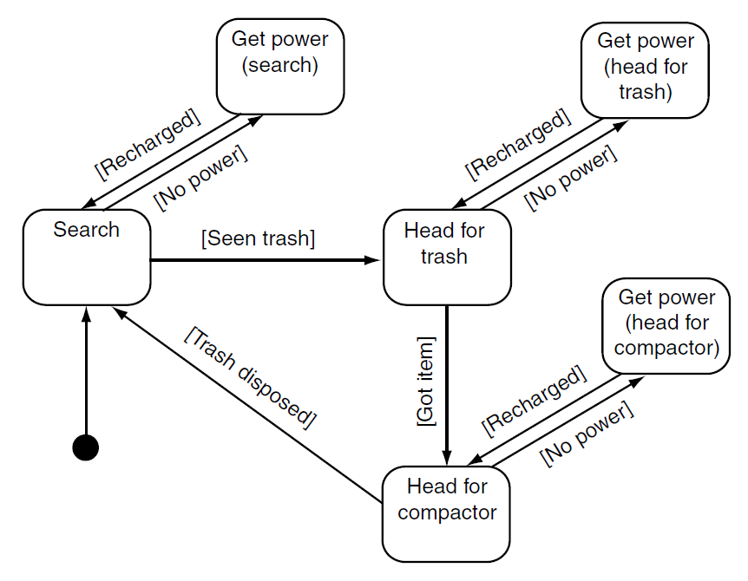
State Machines

Slide 36
Hierarchical State Machines

Slide 37
Finite-State Machine: Approaches
Three approaches
Hardcoded (switch statement)
Scripted
Hybrid Approach

Slide 38
Finite-State Machine: Scripting Advantages
1. Structure enforced
2. Events can be handed as well as polling
3. OnEnter and OnExit concept exists
(If objects, when created or destroyed)
4. Can be authored by game designers
Easier learning curve than straight C/C++

Slide 39
Finite-State Machine: Scripting Disadvantages
Not trivial to implement
Several months of development of language
Custom compiler
With good compile-time error feedback
Bytecode interpreter
With good debugging hooks and support
Scripting languages often disliked by users
Can never approach polish and robustness of commercial compilers/debuggers

Slide 40
Finite-State Machine: Hybrid Approach
Use a class and C-style macros to approximate a scripting language
Allows FSM to be written completely in C++ leveraging existing compiler/debugger
Capture important features/extensions
OnEnter, OnExit
Timers
Handle events
Consistent regulated structure
Ability to log history
Modular, flexible, stack-based
Multiple FSMs, Concurrent FSMs
Can’t be edited by designers or players

Slide 41
Finite-State Machine: Extensions
Many possible extensions to basic FSM
Event driven: OnEnter, OnExit
Timers: transition after certain time
Global state with sub-states (same transitions, different actions)
Stack-Based (states or entire FSMs)
Easy to revert to previous states
Good for resuming earlier action
Multiple concurrent FSMs
Lower layers for, say, obstacle avoidance – high priority
Higher layers for, say, strategy

Slide 42
Finite-State-Machine
Make sure you cover ALL states!

Slide 43
Common Game AI Techniques (1 of 4)
Whirlwind tour of common techniques
Movement
Flocking
Move groups of creatures in natural manner
Each creature follows three simple rules
Separation – steer to avoid crowding flock mates
Alignment – steer to average flock heading
Cohesion – steer to average position
Example – use for background creatures such as birds or fish. Modification can use for swarming enemy
Formations
Like flocking, but units keep position relative to others
Example – military formation (archers in the back)

Slide 44
Common Game AI Techniques (2 of 4)
Movement
A* pathfinding
Cheapest path through environment
Directed search exploit knowledge about destination to intelligently guide search
Fastest, widely used
Can provide information (ie- virtual breadcrumbs) so can follow without recompute
See: http://www.antimodal.com/astar/
Obstacle avoidance
A* good for static terrain, but not with dynamics such as other players, choke points, etc.
Example – same path for 4 units, but can predict collisions so furthest back slow down, avoid narrow bridges, etc.

Slide 45
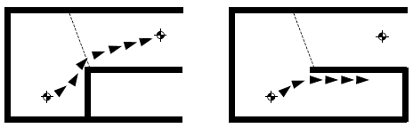
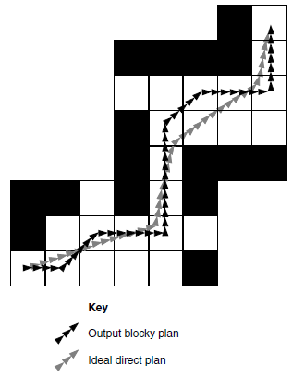
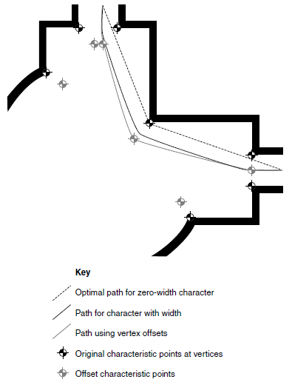
World Representation

Slide 46
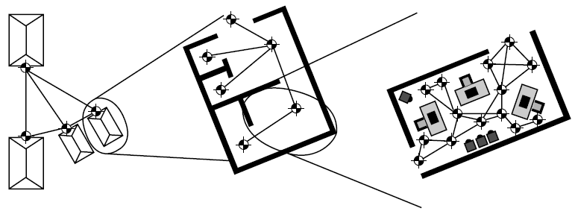
Hierarchical pathfinding
Find Path to a “start/end node”
Find the Next path
Reach destination.

Slide 47
Common Game AI Techniques (3 of 4)
Behavior organization
Emergent behavior
Create simple rules result in complex interactions
Example: game of life, flocking
Command hierarchy
Deal with AI decisions at different levels
Modeled after military hierarchy (i.e. - General does strategy to Foot Soldier does fighting)
Example: Real-time or turn based strategy games -- overall strategy, squad tactics, individual fighters
Manager task assignment
When individual units act individually, can perform poorly
Instead, have manager make tasks, prioritize, assign to units

Slide 48
Common Game AI Techniques (4 of 4)
Influence map
2D representation of power in game
Break into cells, where units in each cell are summed up
Units have influence on neighbor cells (typically, decrease with range)
Insight into location and influence of forces
Example – can be used to plan attacks to see where enemy is weak or to fortify defenses. SimCity used to show fire coverage, etc.
Level of Detail AI
In graphics, less polygonal detail if object far away
Same idea in AI – less computation if won’t be seen
Example – vary update frequency of NPC based on position from player

Slide 49
Promising AI Techniques (1 of 3)
Bayesian network
A probabilistic graphical model with variables and probable influences
Example - calculate probability of patient having a specific disease given symptoms
Example – AI can infer if player has warplanes, etc. based on what it sees in production so far
Can be good to give “human-like” intelligence without cheating or being too dumb
Decision tree learning
Series of inputs (usually game state) mapped to output (usually things they want to predict)
Example – health and ammo → predict bot survival
Modify probabilities based on past behavior
Example – Black and White could stroke or slap creature. Learned what was good and bad.

Slide 50
Promising AI Techniques (2 of 3)
Filtered randomness
Randomness to provide unpredictability to AI
But even random can look odd (ie- if 4 heads in a row, players think something is wrong. And, if flip coin 100 times, there will be a streak of 8)
Example – spawn at same point 5 times in a row, that is bad
Compare random result to past history and avoid repitition
Fuzzy logic
In traditional sets, object belongs or not.
In fuzzy, can have relative membership (ie- hungry, not hungry. Or “in-kitchen” or “in-hall” but what if on edge?)
Cannot be resolved by coin-flip
Can be used in games – ie- assess relative threat, how exposed is enemy

Slide 51
Promising AI Techniques (3 of 3)
Genetic algorithms
Search and optimise based on evolutionary principles
Good when “right” answer is not well-understood
Example – may not know best combination of AI settings. Use GA to try out
Often expensive, so do offline
N-Gram statistical prediction
Predict next value in sequence (ie- 1818180181 … next will probably be 8)
Search backward n values (usually 2 or 3)
Example
Street fighting (punch, kick, low punch…)
Player does low kick and then low punch. What is next?
Uppercut 10 times (50%), low punch (7 times, 35%), sideswipe (3 times, 15%)
Can predict uppercut or, proportionally pick next (ie- roll dice)

